Slide 1
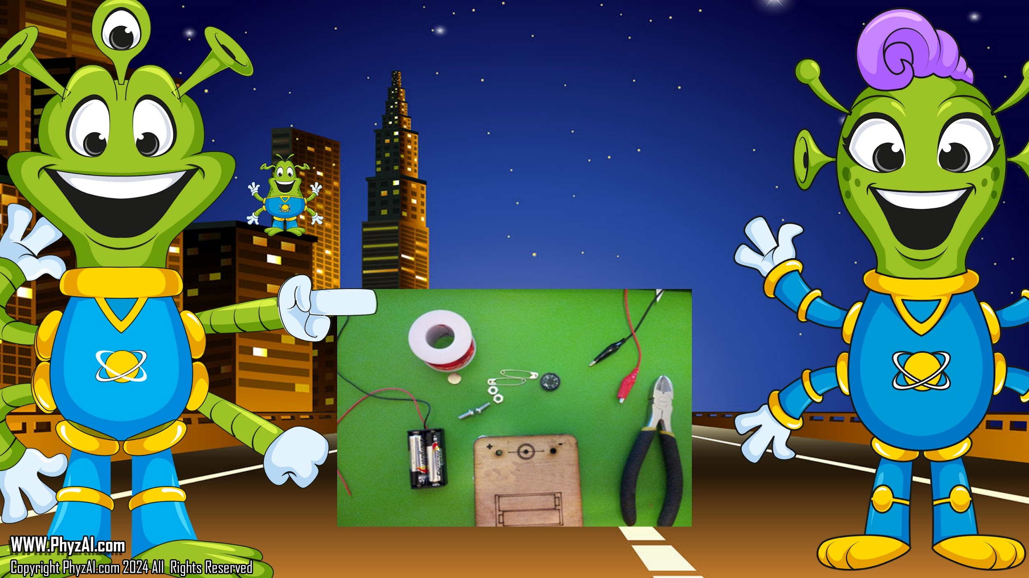
Let's Make
a Motor and use Stored Energy
Notes:
Now that we know how to get stored energy let's look at making that energy into motion with a motor It's time to put our cosmic caps on and delve into the world of motion! With our newfound knowledge of **stored energy**, let's embark on a thrilling quest to transform that dormant power into dynamic action with a motor. Together, we'll spin the wheels of innovation and set our creations into motion!

Slide 2

WARNNING – Rare Earth Magnets are not a toy. Only Adults should handle the Neodymium Magnets in this experiment.
ASTM F963 is a safety standard applicable to toys and other children’s products intended for children younger than 14 years. It also sets requirements for covered products that contain magnets.
Handle with Caution: Neodymium magnets are incredibly strong magnets that can unexpectedly attract to metal surfaces or other magnets. Handle them with care to avoid pinching fingers or catching skin between magnets.
Risk of Swallowing: These magnets are small and can be mistaken for candy. Swallowing magnets can cause serious internal injuries, including intestinal blockages or perforations. Keep them away from small children and pets who might mistake them for food.
Magnetic Interference: Neodymium magnets can interfere with electronic devices such as pacemakers, credit cards, and electronic storage devices like hard drives. Keep them at a safe distance from these devices to avoid any potential damage.
Supervision is Key: Always conduct experiments under adult supervision. If you have any doubts or questions about using neodymium magnets safely, don't hesitate to ask for help from a responsible adult.
Proper Storage: Store neodymium magnets away from small children and pets, ideally in a secure container or drawer where they won't accidentally attract to metal objects or be accessible to those who shouldn't handle them.
Notes:
First a couple of safety items. Rare Earth Magnets or neodymium magnets can be a serious health risk if eaten or put in your mouth. In fact, The US Product safety commission forbids the use of these magnets in toys for children under the age of 14. But we need to use one to make it this work. So please keep in mind only the adult may use these rare earth magnets and must ensure children under the age of 14 are never left unattended with these magnets.

Slide 3

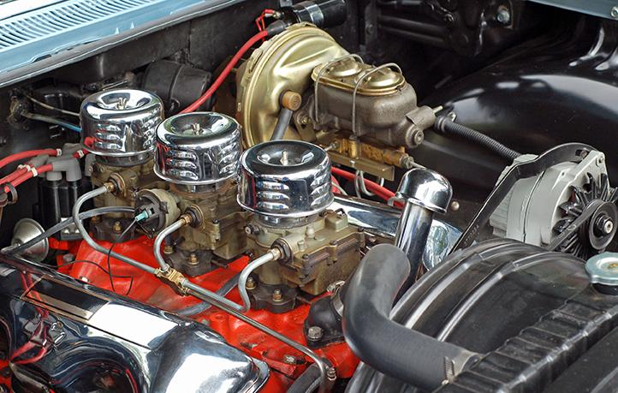
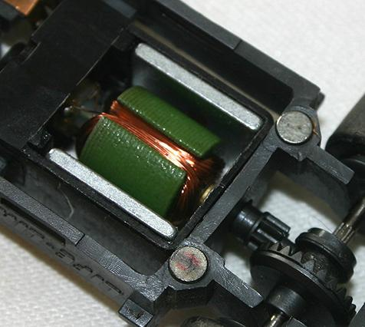
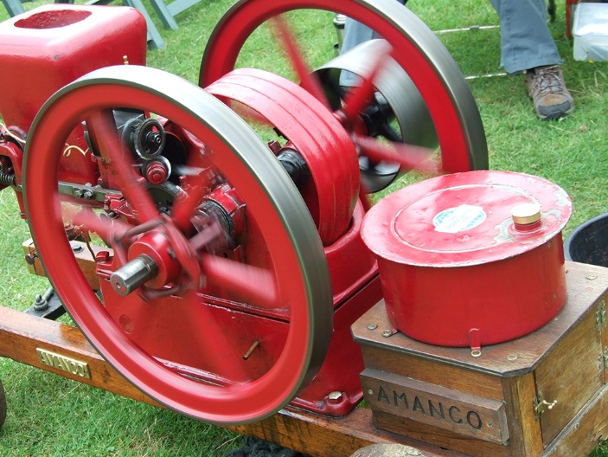
Let's learn more
about motors.
A motor is a device that converts energy into
mechanical
motion.
Notes:
‹#›
A motor is a device that converts energy into mechanical motion.
Quick cosmic joke: Why did the battery feel so good about itself? Because it was fully **charged** with potential!

Slide 4

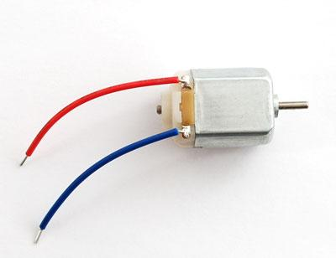
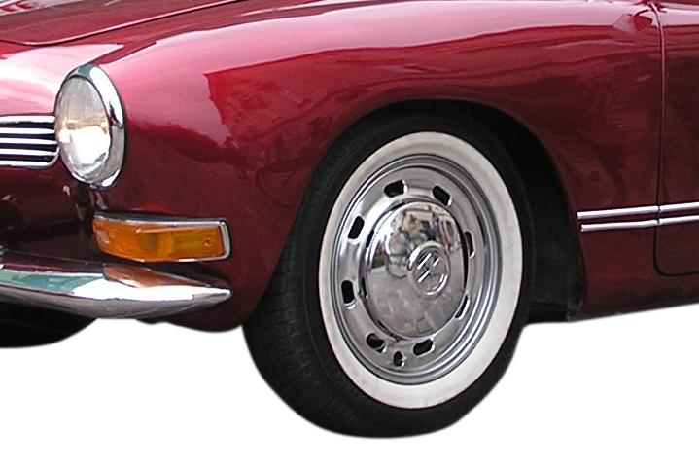
DC Motor
DC motors are made to spin.
As we've seen, DC motors are all about spinning a shaft. By changing the polarity of the power, we can make it turn in either direction.
DC motors are
used for things like
turning the wheels of a car or the propeller
of a plane.
Notes:
‹#›
Today we will explore DC Motors.
DC motors are made to spin. As we've seen, DC motors are all about spinning a shaft. By changing the polarity of the power, we can make it turn in either direction

Slide 5
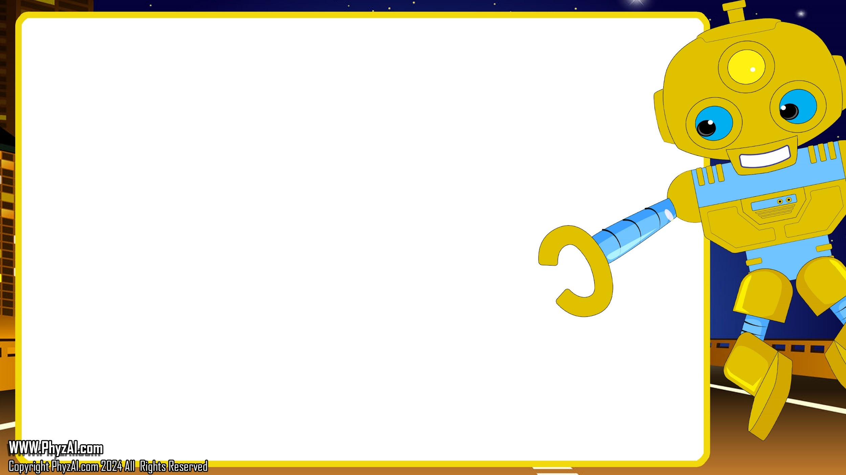
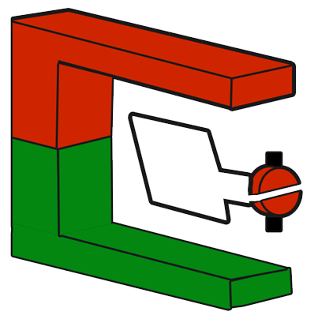

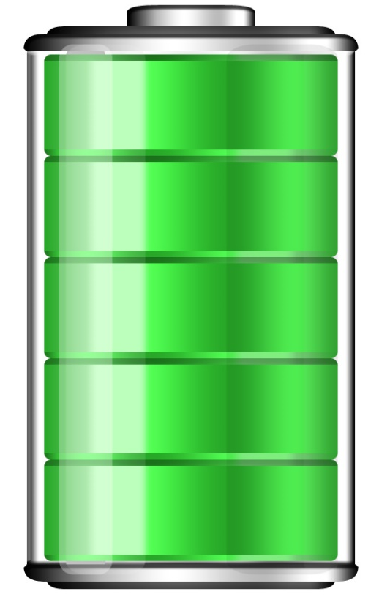

A motor has all the same components as a generator but has energy applied to it, instead of creating energy with it.
P
N
Notes:
A motor has all the same components as a generator but has energy applied to it, instead of creating energy with it.

Slide 6

Let’s make a motor
Notes:
OK! Let’s make a motor

Slide 7

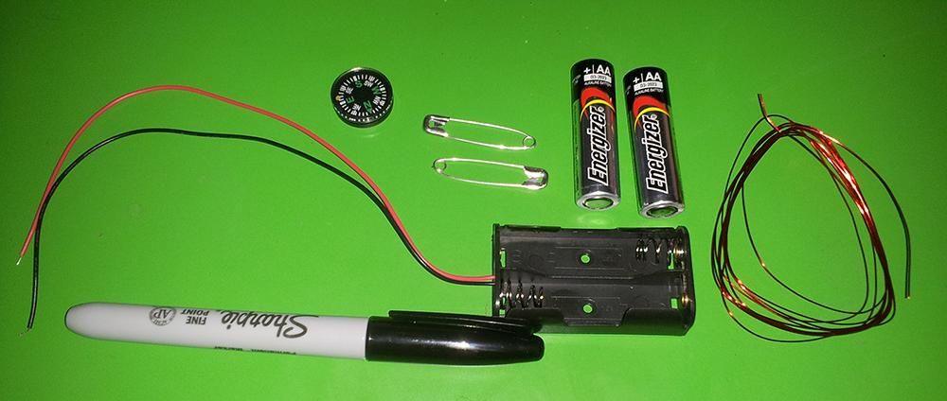
What You'll Need
2 Batteries in Holder 2 Safety pins
2 Nuts + Bolts Magnet
Compass Magnetic Wire
Wire cutter Sharpie marker
Notes:
You will need:
2 Batteries in Holder 2 Safety pins
2 Nuts + Bolts High power Magnet
Compass Magnetic Wire
Wire cutter Sharpie marker Small board or cardboard that you can put two holes in.

Slide 8
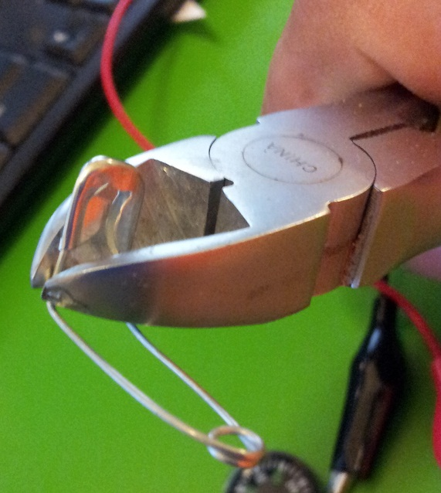
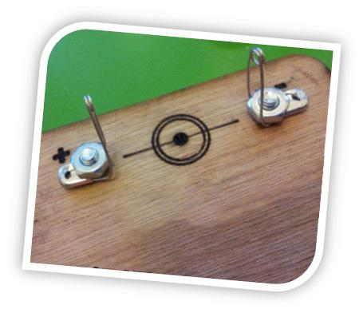
To build our motor, we'll start by putting together the motor platform.
First, using your wire cutters,
bend the safety pins into a 90 degree angle.
Thread the bolts through both the motor platform and the safety pins and use the nuts to secure them into place.
Notes:
To build our motor, we'll start by putting together the motor platform. Thread the bolts through both the motor platform and the safety pins and use the nuts to secure them into place.

Slide 9

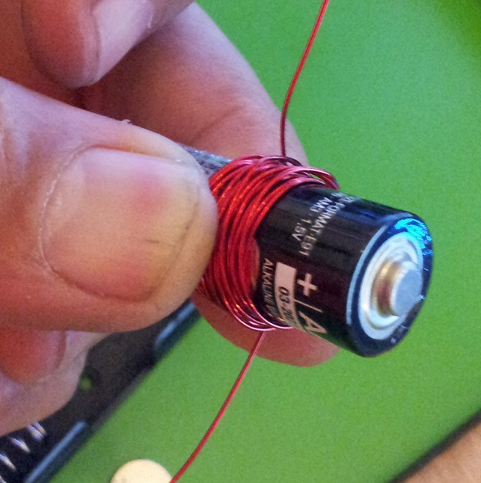
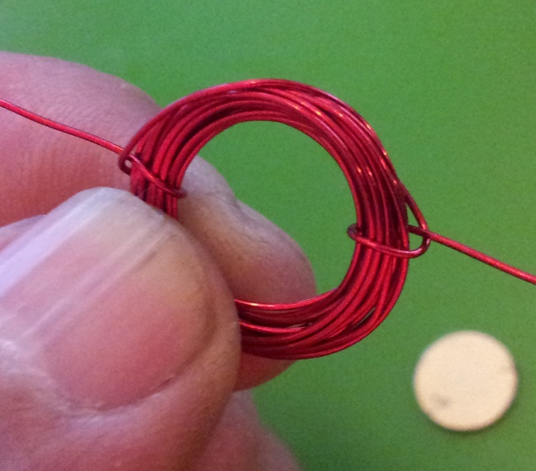

Leaving some extra, wrap the magnetic wire around one of the batteries 20 times, creating a coil of wire.
Remove the coil and tie off the sides with the extra wire.
Use your wire cutters to strip the wire.
Very carefully use your wire cutters to gently strip away the protective coating on the wire threads.
Notes:
Leaving some extra, wrap the magnetic wire around one of the batteries 20 times, creating a coil of wire.

Slide 10

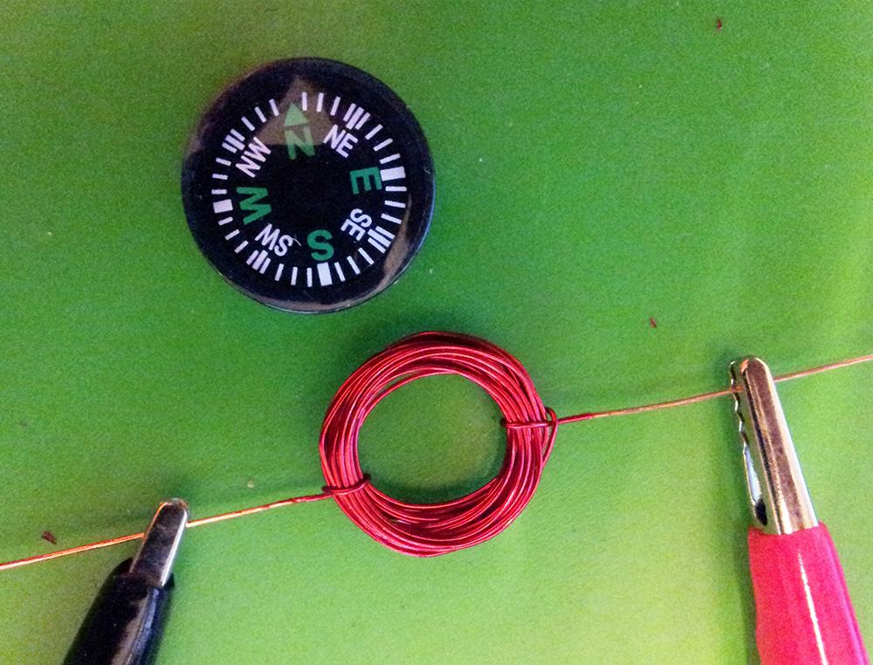
Now that you've
created your magnetic coil, connect the battery to the side wires with the jumper clamps.
To test this, we'll use a compass which reacts to magnetic fields.
What happens when you place the compass close to the magnetic coil?
Notes:
Now that you've
created your magnetic coil, connect the battery to the side wires with the jumper clamps. What happens when you place the compass close to the magnetic coil?

Slide 11
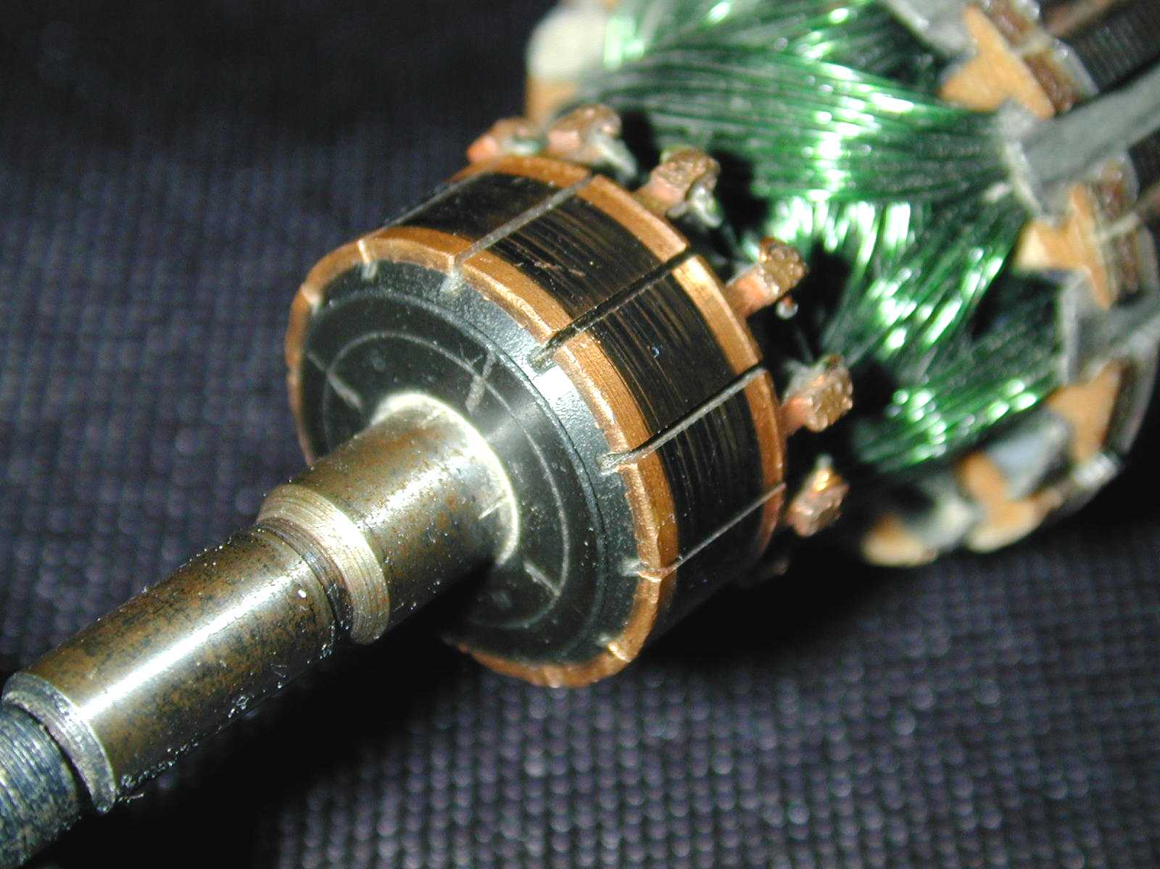
Remember the commutator?
A commutator makes sure the wires stay in contact with the coil as the coil spins.
The commutator is split so only one wire from the coil ever touches one coil at one time.
This is a commutator from a modern
generator. Note it has many sides,
unlike our simple diagram.
Notes:
A commutator makes sure the wires stay in contact with the coil as the coil spins.
The commutator is split so only one wire from the coil ever touches one coil at one time

Slide 12
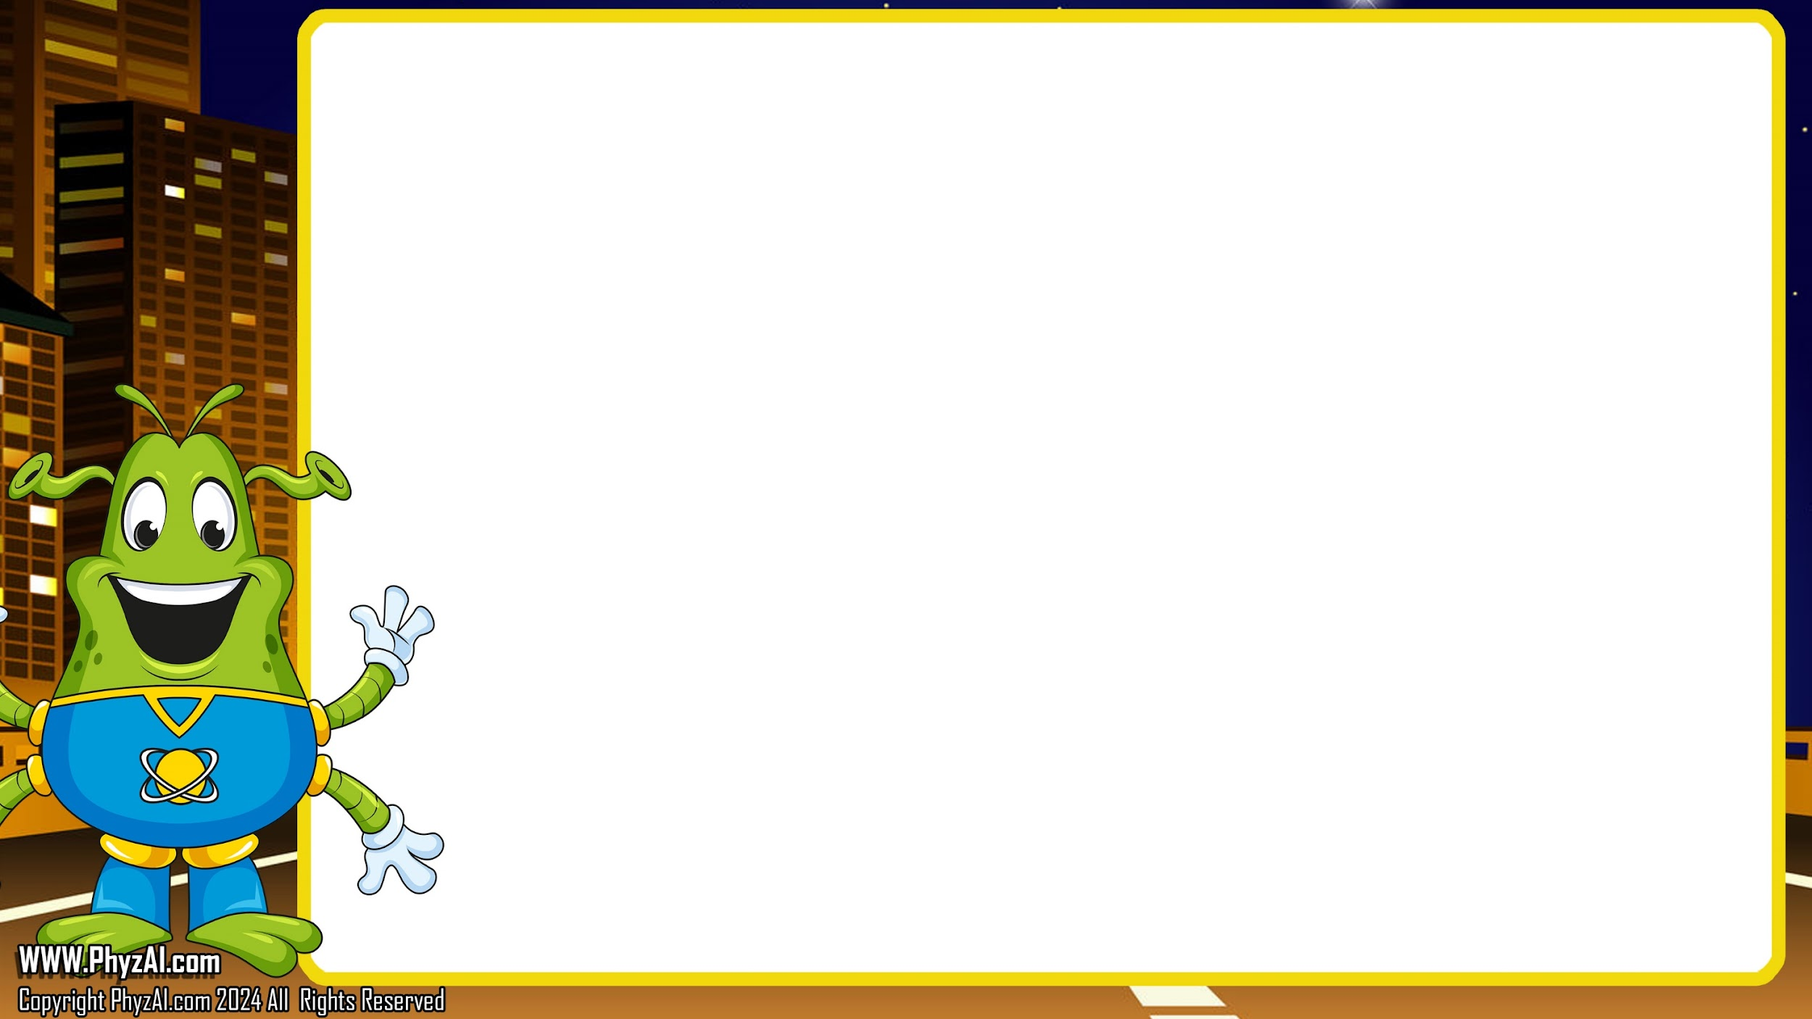
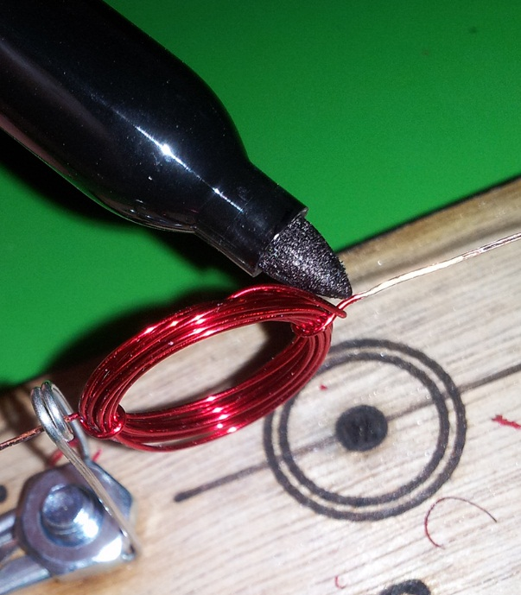
In this case, We make our commutator using a Sharpie and a pin.
Using the Sharpie, carefully paint one side of each wire.
How does this work?
The marker ink is an insulator and will interrupt the electric current, creating the break in charge that is normally achieved by splitting the commutator in half.
Notes:
The marker ink is an insulator and will interrupt the electric current, creating the break in charge that is normally achieved by splitting the commutator in half.

Slide 13

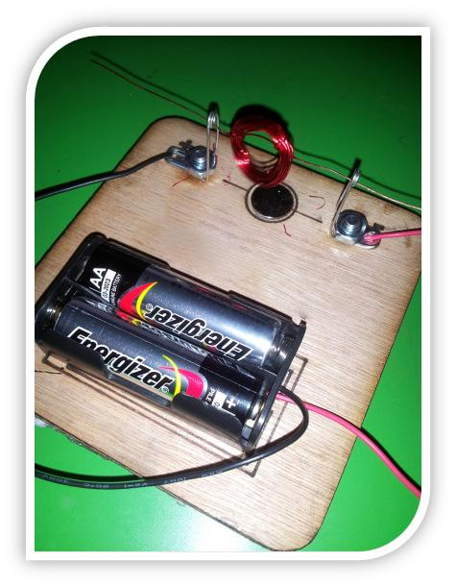
1. Thread the wires through the loops of the safety pins, letting the coil rest there.
2. Hook up the wires from the batteries to the safety pins.
3. Place the magnet in the circle beneath the coil.
4. Give it a push.
5. Watch it spin!
1.
3.
2.
Notes:
Let’s do these 5 steps:
1. Thread the wires through the loops of the safety pins, letting the coil rest there.
2. Hook up the wires from the batteries to the safety pins.
3. Place the magnet in the circle beneath the coil.
4. Give it a push.
5. Watch it spin!

Slide 14
1.
Check the distance between the coil and magnet
The closer they are the better it will spin
Notes:
If your motor's still on a lazy space float and not spinning, let's do a quick spacewalk and inspect the gap between the coil and the magnet. Just like planets in orbit, the closer they are the stronger the pull - and that means a super spin! Adjust them to be near, like two stars cozying up in the cosmos, and watch the magic happen!

Slide 15
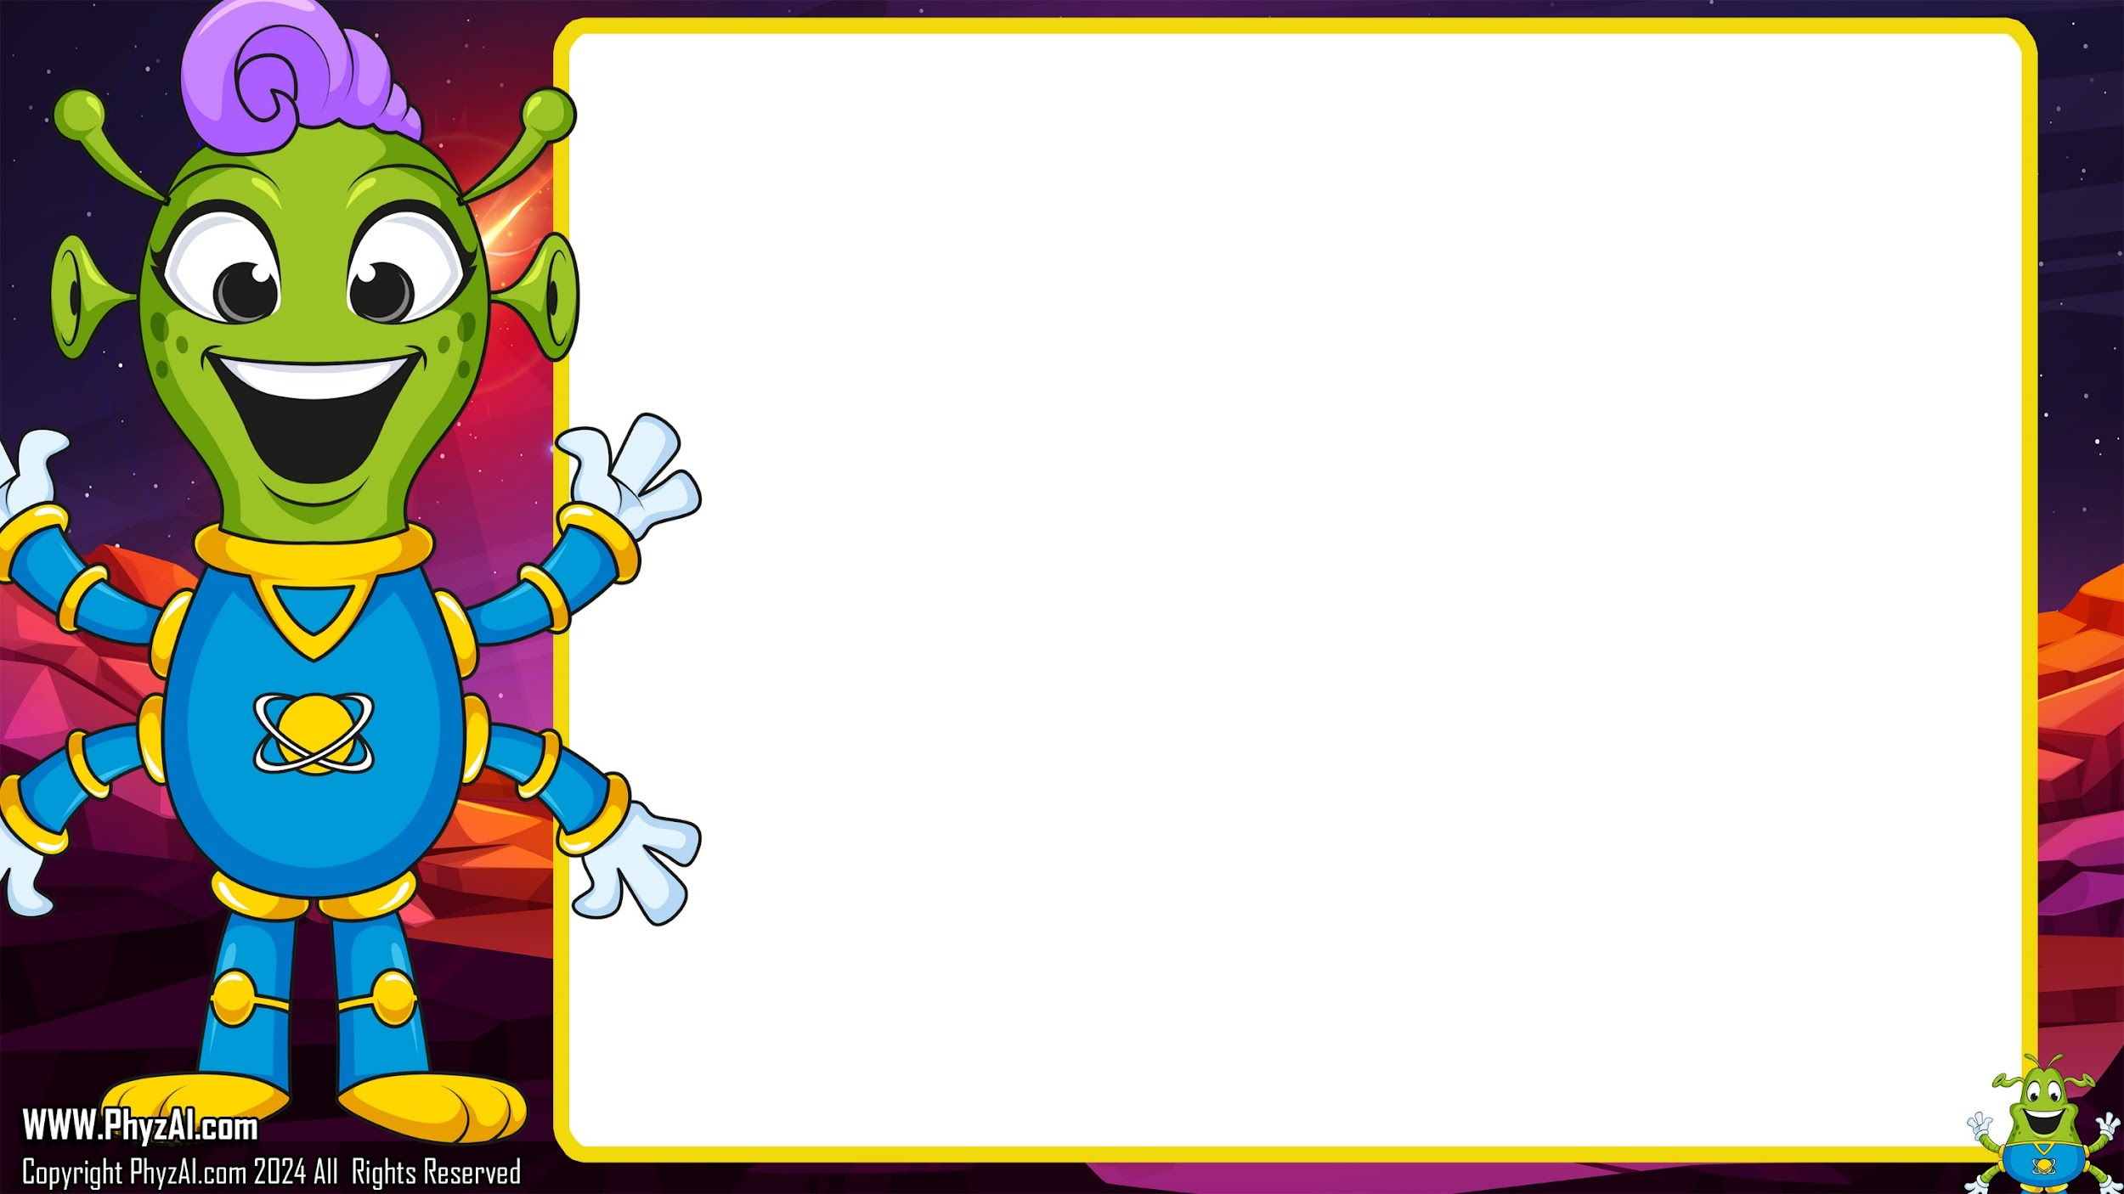
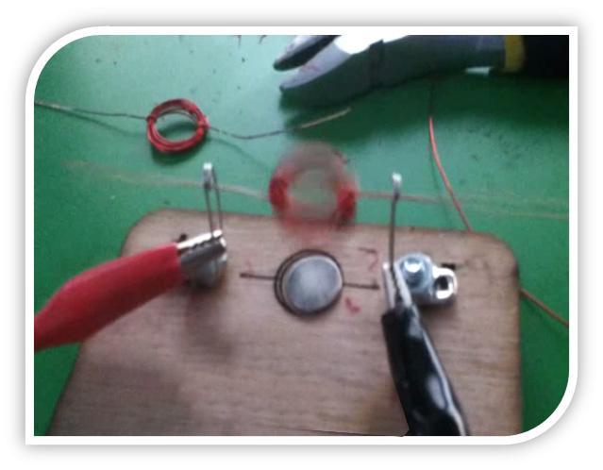
My motor isn't spinning!
Check a few things.
Are the magnet and the coil close enough to each other? It requires close proximity to make that coil spin.
Is there enough Sharpie
on your wire? It’s
important to break up
the energy with the
Sharpie ink commutator.
Notes:
Hmm still not spinning? Let's check your wire – is it decked out with enough Sharpie art? You see, in this galaxy of gadgets, the Sharpie ink acts like a starship commutator, breaking up the energy so we can get things spinning! Make sure it’s marked up just right, like drawing constellations on the night sky, and soon we’ll be in motion!

Slide 16
Notes:
Whoosh! You've just zoomed past a major milestone in energy transformation! You've taken stored energy and turned it into the power of movement - that's like waking up a sleeping asteroid with a cosmic tickle!
Just one more zany twist in the space wrench, and we'll have the engines of my star cruiser humming like a choir of interstellar crickets. Can't wait to see you at the next lesson, where we'll spark more curiosity and shoot for the stars!
Keep your antennas tuned, Over and out!

